Slide 1
Krill Respirometry Study
2021.0

Slide 2
Table of Contents
Conditions prior to Respirometry
Water Conditions prior to Respirometry
Respirometry Project Information
Merging
DO Correction
Units of Time
Animals Per Trial, Per Treatment Tables
Timeseries Plots (prior to slope function)
Outlier Removal
Slope Generation, Blank Slope Averages, positive slope removal, and animal weight corrections
Slopes Plots

Slide 3
Conditions Prior to Respirometry – Dates of Respirometry Rounds
Two rounds of respirometry were conducted on Monday October 28th with two subsequent rounds on Tuesday October 29th, 2019.
28OCT19 – Day One of Respirometry
29OCT19 – Day Two of Respirometry
27OCT19 Clean out – Fasting Start 1230
28OCT19 Clean out – Fasting Start 1230
MOATS 02
MOATS 06
MOATS 08
MOATS 12
MOATS 01
MOATS 07
MOATS 10
MOATS 11
MOATS 13

Slide 4
Conditions Prior to Respirometry – Fasting Period Actions
To achieve a 24hour fast for all animals MOATs 2, 6, 8, and 12 were not fed and EZ larva and Artemia cysts remaining were siphoned away/vacuumed out on Sunday 27OCT19.
On Sunday 27OCT19, remaining MOATs were fed per routine after 1230 local. Diet inputs were introduced following the 1230 shut off.
EZ larva remnants and Artemia cysts for MOATs 1, 7, 10, 11, and 13 were siphoned away/vacuumed out the morning of 28OCT21 prior to 1230.

Slide 5
Conditions Prior to Respirometry – Source Water Conditions
All krill were removed during the night period when water chemistry pH conditions drifted to their higher conditions and dissolved oxygen returned to 100%.
MOATs 12 “system water”, water outside the animal box, was exclusively used for respirometry. Water was pulled during nighttime conditions to pre-fill the 250mL jars, 28mL, and catch basins.
Sorting jars were kept in a chilling water bath prior to loading a krill into a vial. The chiller maintained a water temperature between 11.0 ~ 11.4°C.
The PreSens DO probe was set to HUMID, mg/L, with a manual temperature set to 11°C, and pressure set to 1atmosphere.

Slide 6
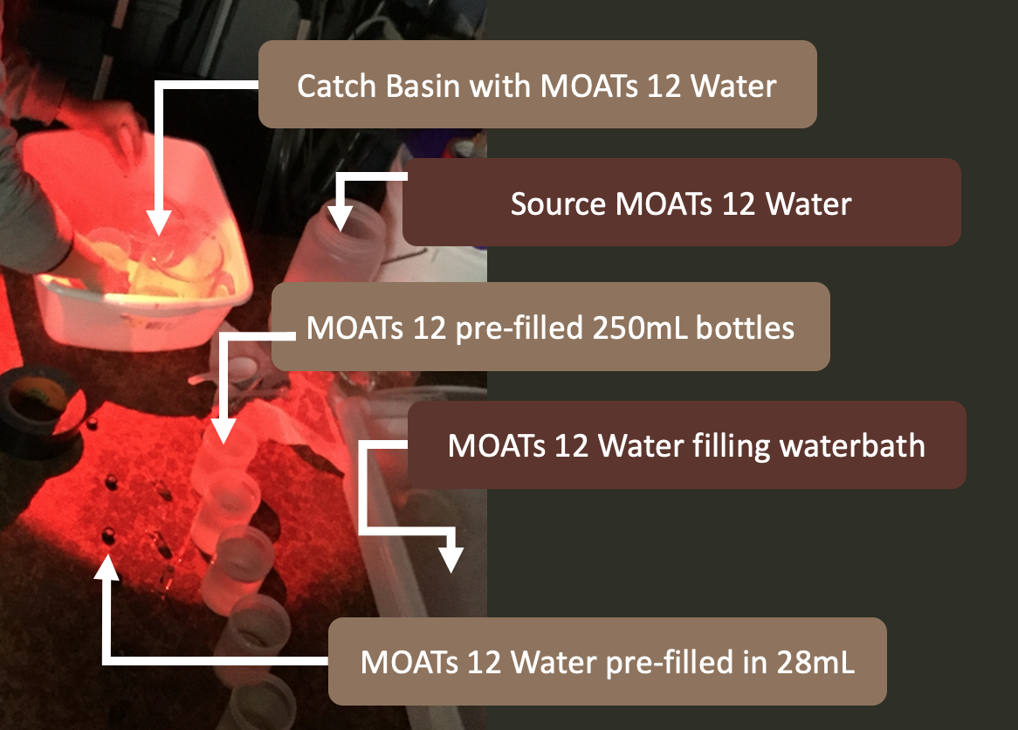
Conditions Prior to Respirometry – Source Water Conditions
MOATS 12
The chiller maintained a waterbath temperature between 11.0 to 11.4°C.
The PreSens DO probe was set to
HUMID,
mg/L
Manual Temperature set to 11°C,
Pressure set to 1atmosphere

Slide 7
Respirometry Project Information – “MUK_KRL2019respirometry90min” Repository
R scripts and documents inside the project listed above was generated to create slopes, intercepts, and apply linear/mixed effects models to the slopes. Only observations included in a 90minute observation were included.
No. | Description | Link
1 | Overall Respirometry | https://github.com/KROVINSKI/NWFSC.MUK_KRL2019respirometry90min
2 | “KRL_ADLT_EXPOcross_RESPRSlopeGen_2019_(2021.04.30).Rmd” Rnotebook document – Generating initial database | https://github.com/KROVINSKI/NWFSC.MUK_KRL2019respirometry90min/tree/master/03_scripts
3 | “KRL_ADLT_EXPOcross_RespirometryDataframeCreation_Summer2019_(2021.04.30).Rmd” Rnotebook document – document creating slopes and analysis

Slide 8
Respirometry Project Information – Merging
The database is created by merging two datafiles that brought together:
1.) observer data collected data
(NIKON SMZ715T with Sony Camera manufactured by Imaging Source (DFK 33UX226c) and IC capture and measure software packages)
and
2.) PRESENS (PreSens optical oxygen Fitbox4 sensor). The merged dataframe was referred to as “DRESPmsr”.

Slide 9
Respirometry Project Information – Merging
dRESP
4.1a Creating the database
Google Drive | dRESP <- read.csv(file = “KRILL_Resp_alltrials.csv”, stringsAsFactors = FALSE) dim(dRESP) | dRESP
https://drive.google.com/file/d/19veU1VIWJSrzlMEoVsmDicNNEKG-kWpW/view?usp=sharing
Google Drive | dRESPanimal <- read.csv(file = “RespirometryTrials_all.Animal.Info.csv”) dim(dRESPanimal) | dRESPanimal
https://drive.google.com/file/d/1vdumqXO0O-3-htxKjtagctW3YLOZoGj3/view?usp=sharing
Google Drive | dRESPmsr <- merge(dRESP, dRESPanimal, by=”SensorName”) | dRESPmsr
https://drive.google.com/file/d/1pWiqUsxNBWs5nYindWgORBDG9eMeg4sB/view?usp=sharing
dRESPmsr
dRESP
animal

Slide 10
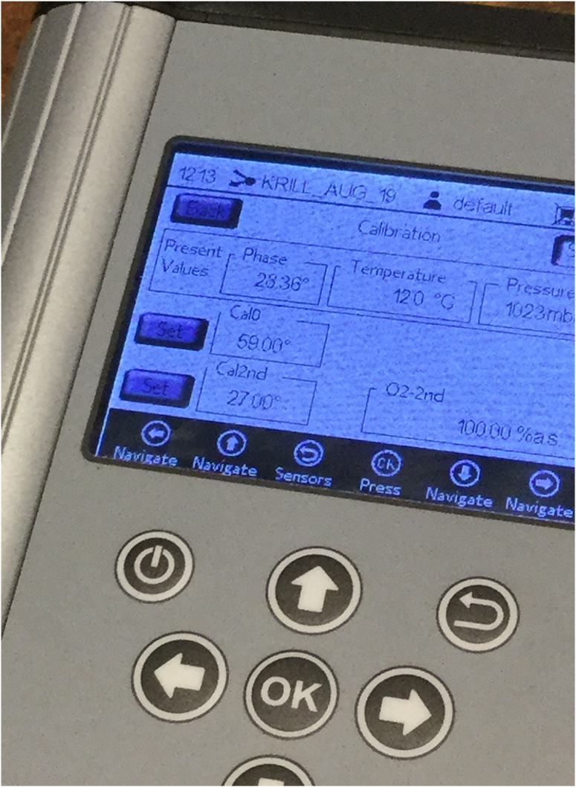
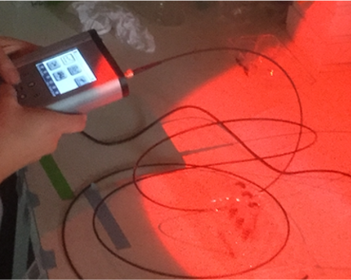
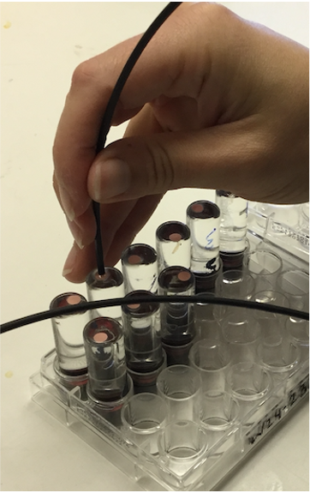
Respirometry Project Information – Respirometry Data Corrections
Corrections were needed for dissolved oxygen measurements, vial volume corrections for animal size and krill density calculations
PRESEN presets corrections
Vial Volume Corrections
Krill Density Corrections

Slide 11
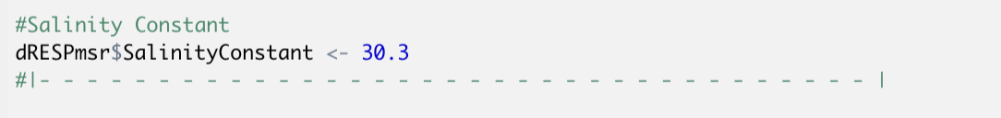
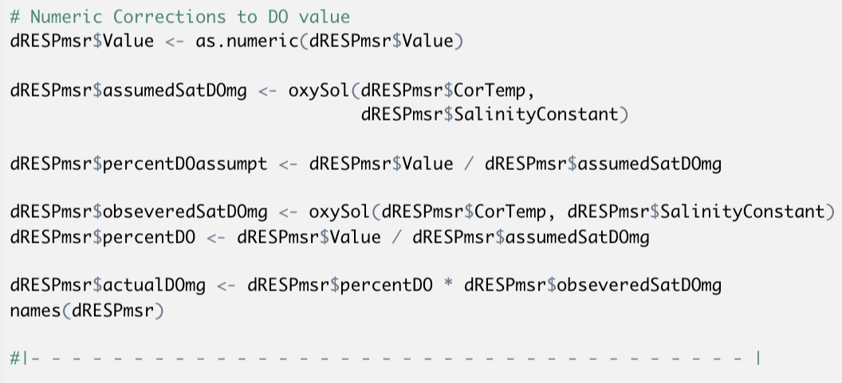
Respirometry Data Corrections – Dissolved Oxygen Measurement Corrections
On Trail 03 of Respirometry Day 02 the PRESENS default temperature of 14°C was entered.
All krill under respirometry trials were kept in a water bath between 11.4-12℃.
To correct for this temperature correction, Salinity constant was taken from the water supply MOATs 12 (30.3PSU) and modified with the package “wql”.

Slide 12
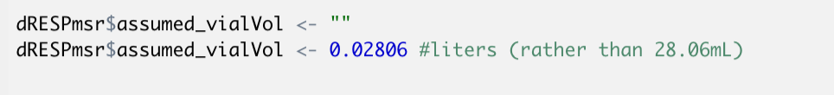
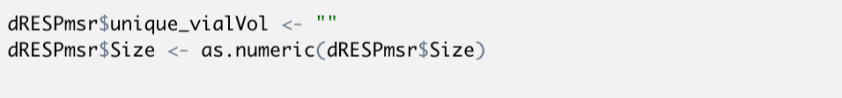
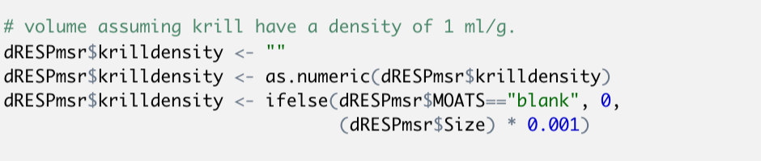
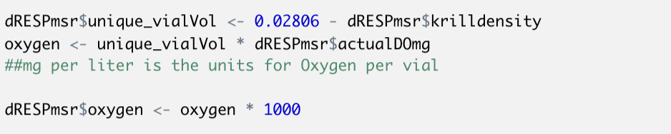
Respirometry Data Corrections – Vial Volume & Density Corrections
Vial volume was .02806.
PRESENS probe measured Dissolved Oxygen as mg/L.
Displaced vial volume assuming krill have a density of 1 ml/g

Slide 13
Respirometry Data – Dataframe & variable generation
dRESP
dRESPmsr
DO temp correction
mg
28.06mL
dRESP
animal
L
1
oxySol function wql package
Actual Do mg/L
Vial Volume

Slide 14
Respirometry Data – Dataframe & variable generation
dRESP
dRESPmsr
DO temp correction
mg
28.06mL
dRESP
animal
L
1
oxySol function wql package
Actual Do mg/L
Vial Volume

Slide 15
Respirometry Data – Dataframe & variable generation
dRESP
dRESPmsr
DO temp correction
mg
.02806L
dRESPmsr $ oxygen
dRESP
animal
L
1
mg
oxySol function wql package
Actual Do mg/L
Vial Volume

Slide 16
Respirometry Data – Dataframe & variable generation
dRESP
dRESPmsr
DO temp correction
mg
.02806L
dRESPmsr $ oxygen
dRESPmsr $ oxygen
1000
dRESP
animal
L
1
mg
µg
oxySol function wql package
Actual Do mg/L
Vial Volume

Slide 17
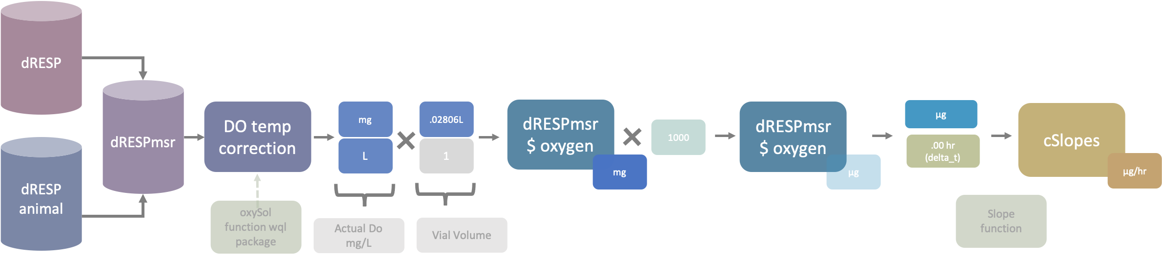
Respirometry Data – Units of Time between observations
Observations were collected from start to an elapsed 90minutes
The “delta_t” value will increase until an approximate value of ~1.5hrs.
Units of Time “delta_t”
Cumulative Amount of Time (.00hr)

Slide 18
Respirometry Data – Dataframe & variable generation
dRESPmsr $ oxygen
µg
cSlopes
(correction via) Blank Mean values (per trial)
Corrected Slope Values
Corrected Slope Values
Final slope values
µg/min
µg/min
.00 minutes
Animal Wet Weight
Animal Wet Weight
µg
µg/min
mg
1000
µg oxygen/min
µg
Slope function
µg Krill Tissue

Slide 19
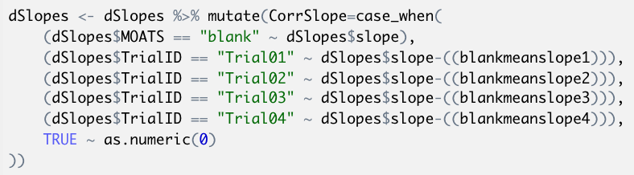
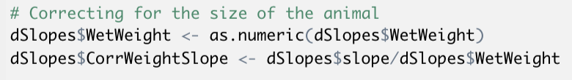
Respirometry Data – Dataframe & variable generation
cSlopes
(correction via) Blank Mean values (per trial)
Corrected Slope Values
Corrected Slope Values
Final slope values
µg/min
µg/min
Animal Wet Weight
Animal Wet Weight
µg oxygen/min
µg/min
mg
1000
g
g Krill Tissue

Slide 20
Respirometry Data – Animals Per Trial, Per Treatment Tables
The tables below detail how many animals have been included in each trial 01-04 in the following slides detail each trial.
The tables break down the distribution of animals between treatments.
The Ambient Treatment was initially included but ultimately excluded due to a lack of consistent monitoring and equipment logs from both MOATs 04 and MOATs 05.
60 vials in total, 52 animals
2 blanks per trial

Slide 21
Respirometry Data – Trial 01 Respirometry Table

Slide 22
Respirometry Data – Trial 02 Respirometry Table

Slide 23
Respirometry Data – Trial 02 Respirometry Notes
A new loading map needed to be made on Monday following continued water chemistry problems on the MOATs following the 18-19OCT21 winter storm event.
Barcodes for the first round of respirometry were printed prior to 1230 but not the second round. There was an error with barcodes and that batch of 19 needed to be reprinted.
Loading began on the second trial with only one person and without jars already filled with source water. This led to a longer loading time in Trail 02. 250mL jars of source water were submerged in the 11-11.4°C chilled water bath.
This problem with loading and barcodes, along with lipid preparation organization was a lesson learned the project. Four people is the minimum number of people to work simultaneous respirometry and lipids prep. Allow two people to be dedicated vial loaders (follow on lipids prep) and two people to be dedicated PreSens operators.

Slide 24
Respirometry Data – Trial 03 Respirometry Table

Slide 25
Respirometry Data – Trial 03 Respirometry Notes
Noticed a 4 minute difference between acclimation stop time and first measurement by the PreSens. This observations were removed.
obstrial3 <- subset(dRESPmsr, dRESPmsr$TrialID == "Trial03")
926 observations of 65 variables
obstrial3 <- filter(obstrial3,
Time >= as.POSIXct("2019-10-29 14:10:00", tz = "UTC"))
844 observations of 65 variables
82 observations were removed

Slide 26
Respirometry Data – Trial 04 Respirometry Table

Slide 27
Respirometry Data – Trial 04 Respirometry Notes
Noticed a three-minute difference in measurement time
obstrial4 <- subset(dRESPmsr, dRESPmsr$TrialID == "Trial04")
477 observations of 65 variables
obstrial4 <- filter(obstrial4,
Time >= as.POSIXct("2019-10-29 17:23:00", tz = "UTC"))
448 observations of 65 variables
29 observations removed

Slide 28
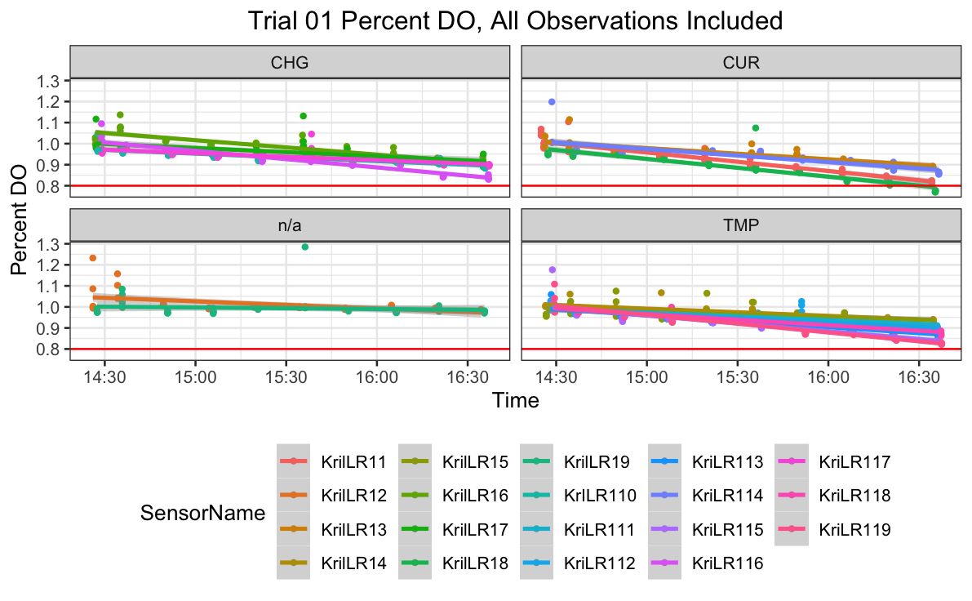
Respirometry Data – Timeseries Plots Trial 01 (prior to slope function)

Slide 29
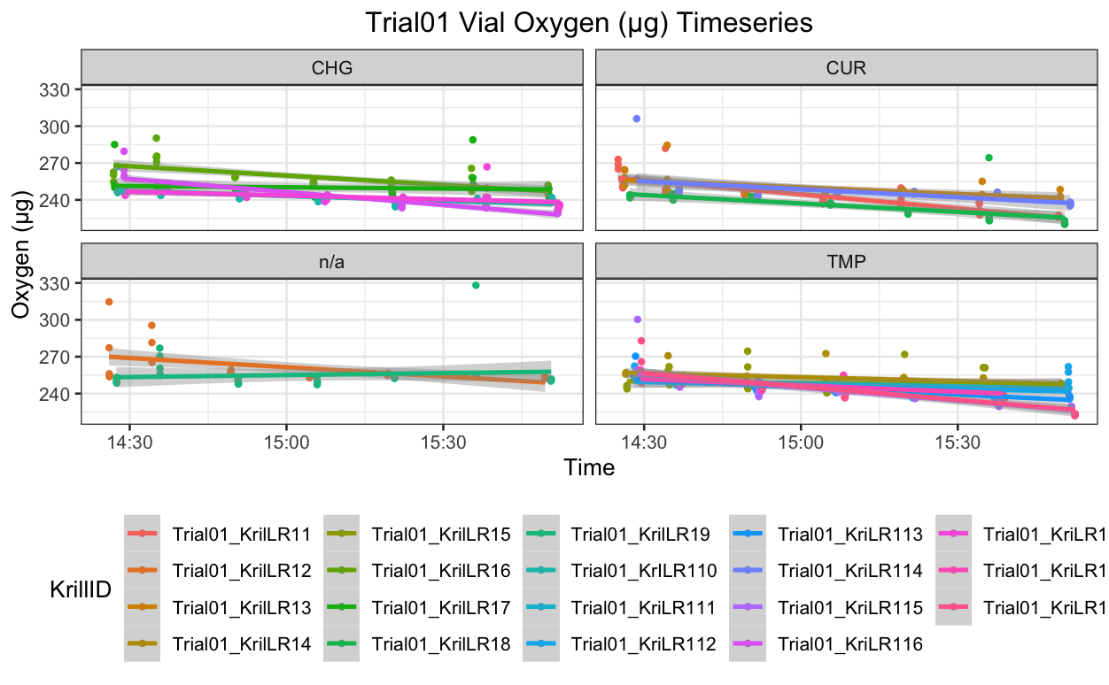
Respirometry Data – Timeseries Plots Trial 01 (prior to slope function)

Slide 30
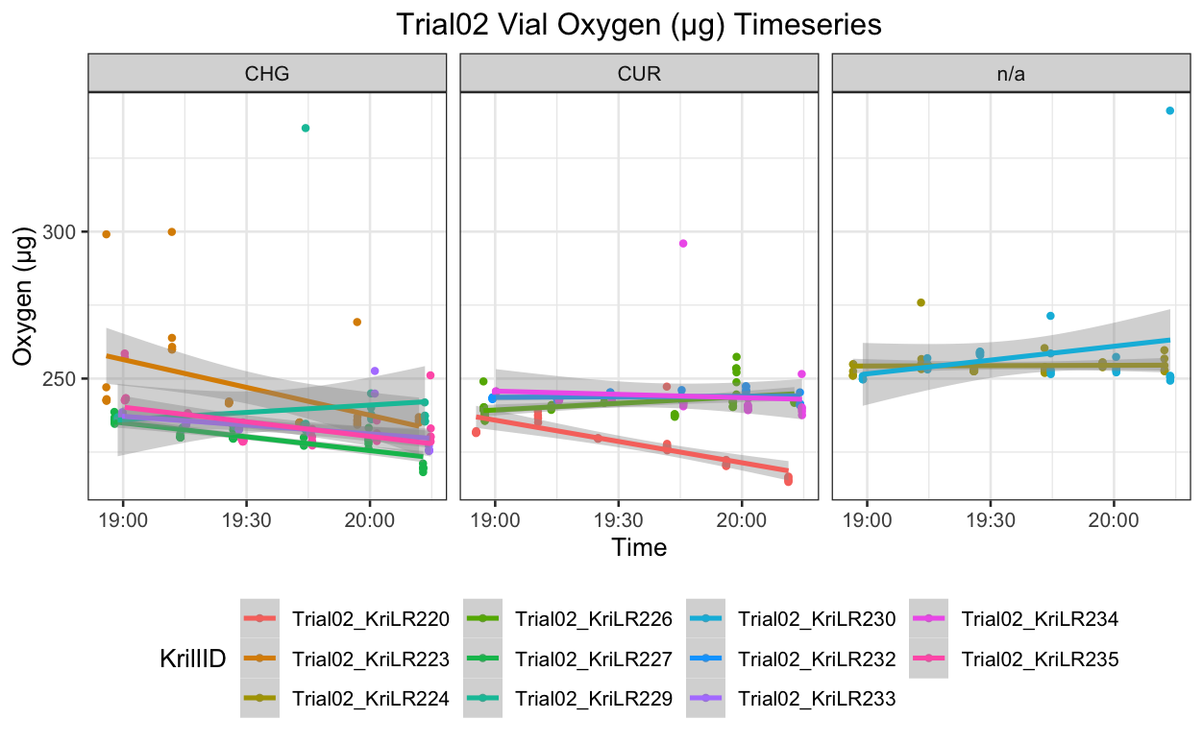
Respirometry Data – Timeseries Plots Trial 02 (prior to slope function)

Slide 31
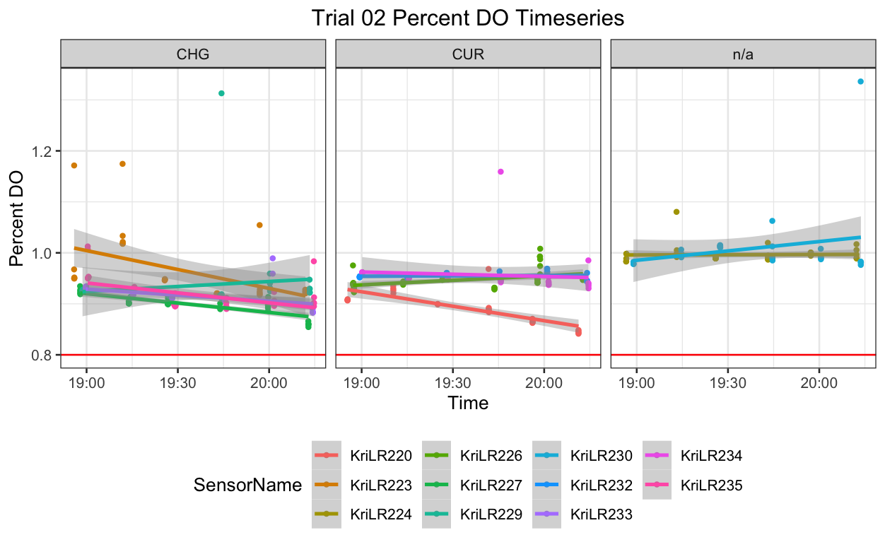
Respirometry Data – Timeseries Plots Trial 02 (prior to slope function)

Slide 32
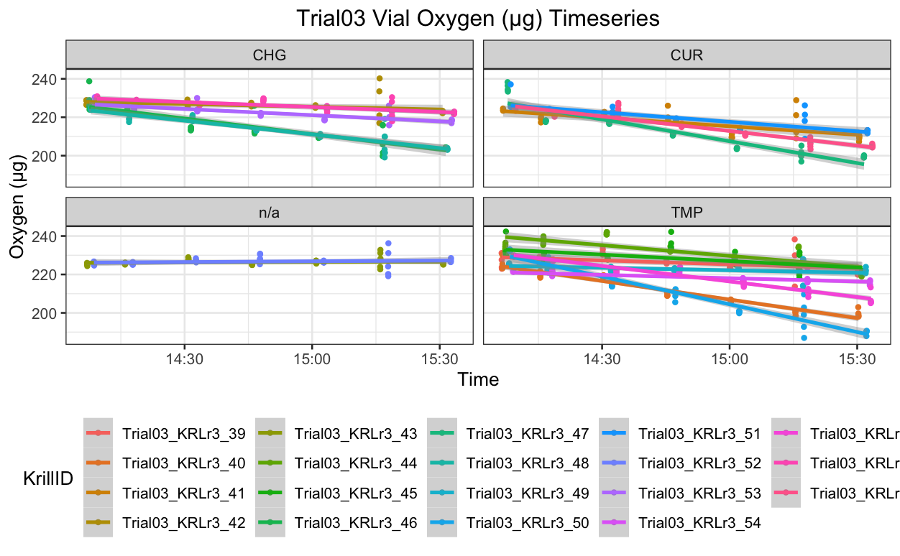
Respirometry Data – Timeseries Plots Trial 03 (prior to slope function)

Slide 33
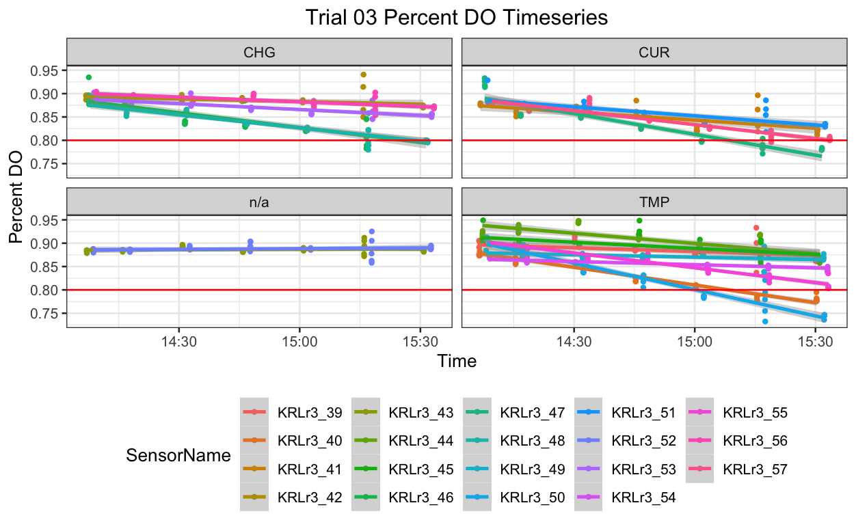
Respirometry Data – Timeseries Plots Trial 03 (prior to slope function)

Slide 34
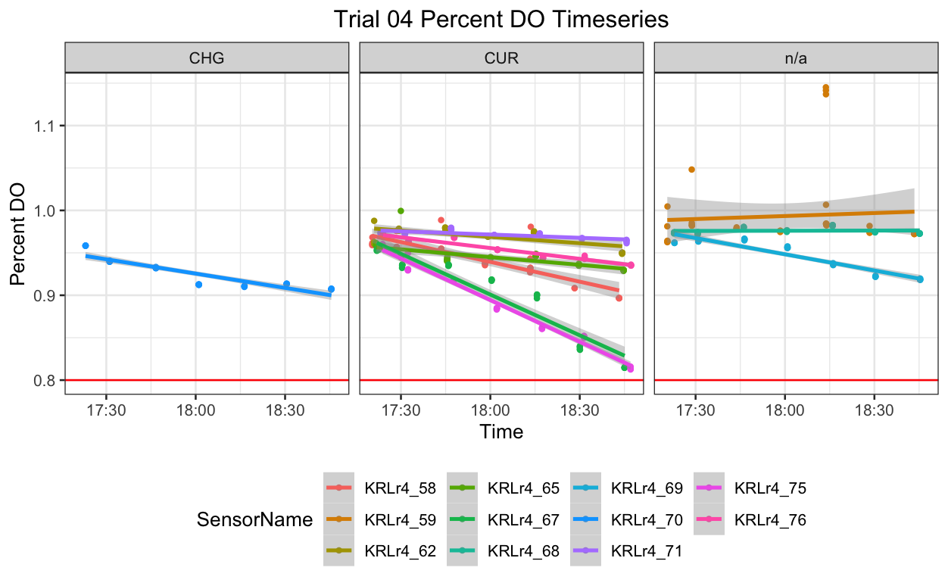
Respirometry Data – Timeseries Plots Trial 04 (prior to slope function)

Slide 35
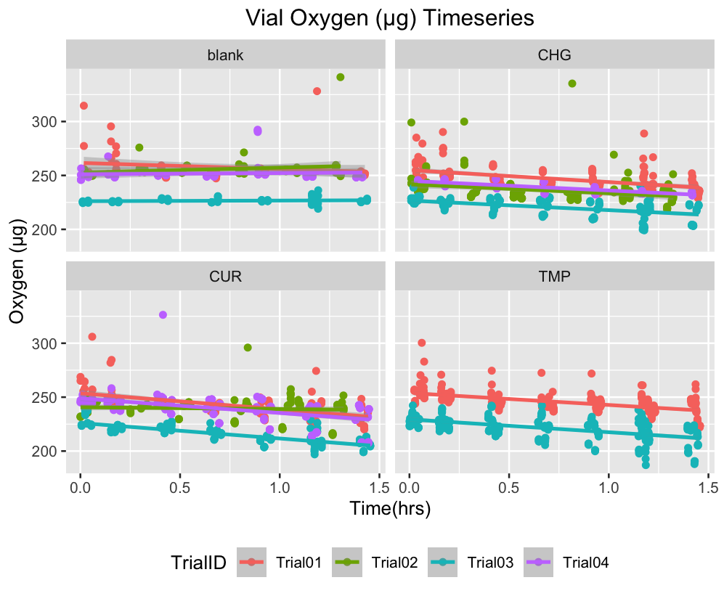
Respirometry Data – All Trials, Across Treatments Oxygen (μg) Reduction
All trails are included. 52 animals and 8 blank vials are included in the figures above.
Trail 02 experienced the longest loading and acclimation time due to only person loading.

Slide 36
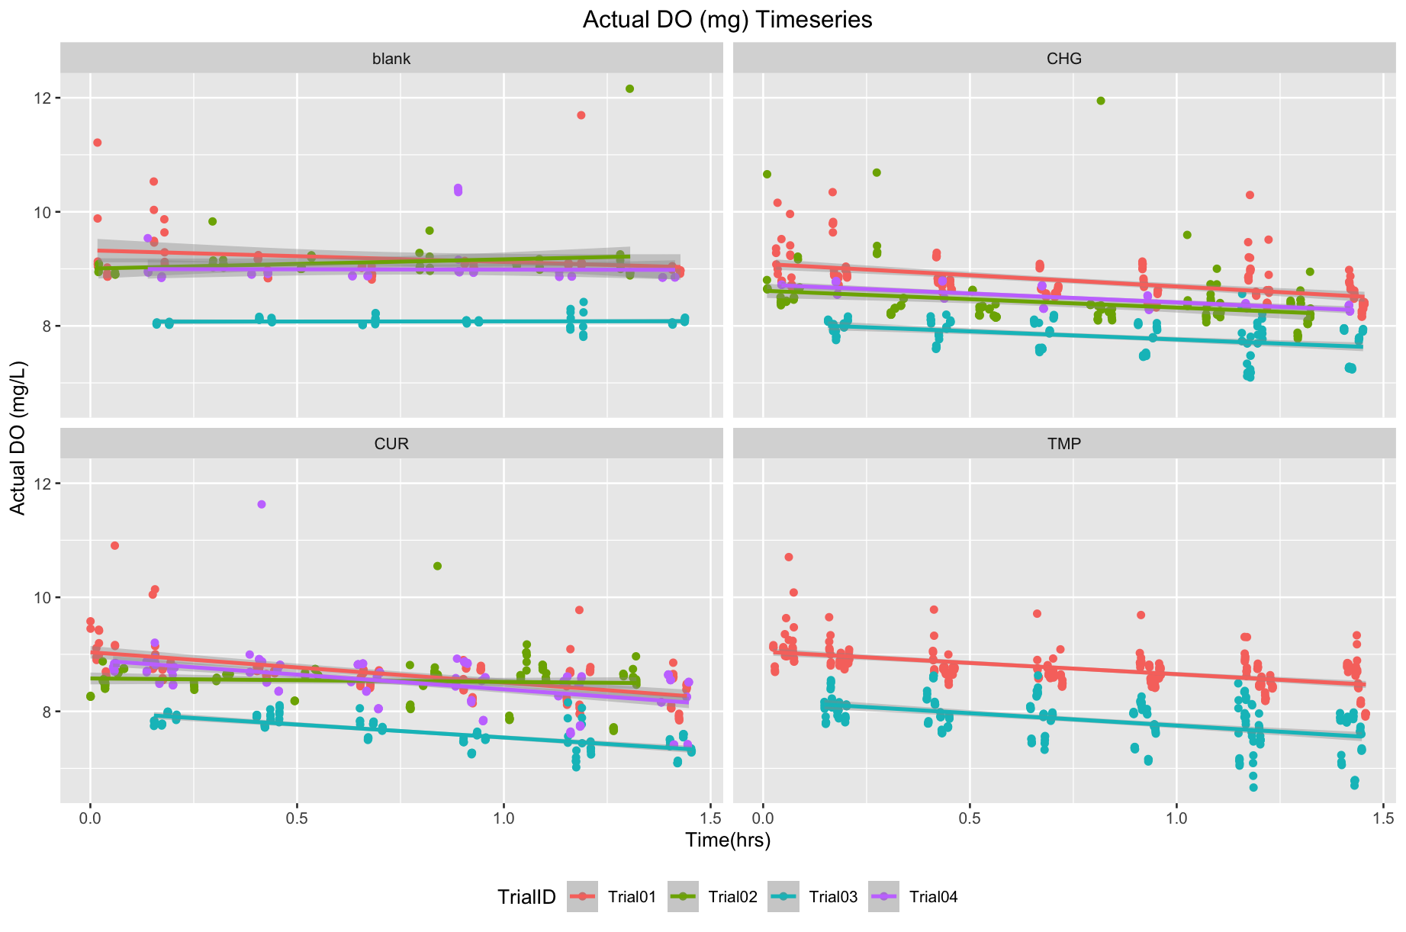
Respirometry Data – All Trials, Across Treatments Oxygen (μg) Reduction

Slide 37
Respirometry Data – All Trials, Loading and Acclimation Time

Slide 38
Respirometry Data – Outlier Removal
Removing outliers was a six-step process to remove observations that had a Cook’s Distance above 4/n.
All slopes were included for the outlier removal function. There was no minimum reduction in oxygen consumption.
Positive Slopes were later removed.

Slide 39
Respirometry Data – Outlier Removal Functions
Six Step Outlier Removal Function

Slide 40
Respirometry Data – Slope Corrections
Blank Slope Averages & Correcting Slopes based on blank vials and animal wet weight
Blank Mean Slope Trial 01 | -12.9572
Blank Mean Slope Trial 02 | -6.7701
Blank Mean Slope Trial 03 | -8.58243
Blank Mean Slope Trial 04 | -8.91736

Slide 41
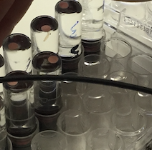
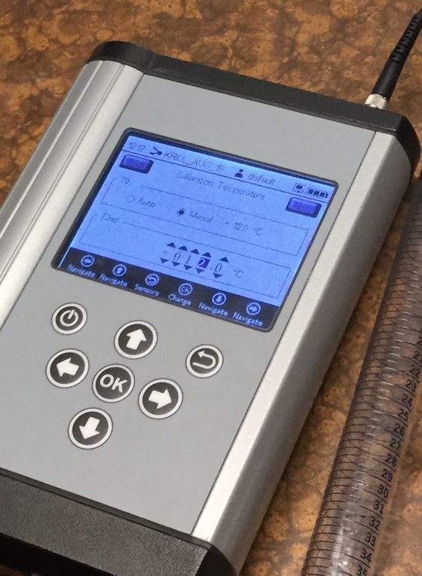
Respirometry Data – Slope Corrections

Slide 42
Slopes Plots
Notes:
Units of the Measurement - µg O2 h⁻¹ g⁻¹
All slopes represent only negatives slopes as their absolute values
Krill Respirometry Literature (Units)
Oiller et al 2018 = μg O₂ h ⁻¹ g ⁻¹ when referencing a resting metabolic rate.
General Respirometry Literature (Units)
Chabot et al 2016 MO₂ = μmol O₂ min ⁻¹ kg ⁻¹
Zimmerman 2001 MO₂ = mg O₂ h ⁻¹ & mg O₂ h ⁻¹ kgWM ⁻¹
I don’t know that we need to spell out wet mass but we can

Slide 43
Slopes Plots
Notes:
This test ordered All Change Conditions against current conditions, followed by High Temperature Conditions.
No Treatment Effect Found; All Change Treatment compared to Current Conditions (p =0.23) and Current to High Temperature Conditions (p = .12).
Random Effects Model large variance (27579) within-treatment level indicates a MOATs effect is relatively small.
No treatment effect observed, no MOATs effect observed
Direct Comparison of Current Conditions to High Temperature Corrected Slope values (p = .70) doesn’t reveal a significant relationship.

Slide 44
“dSlopes.summary” Table
“dSlopes.summary” Table (Corrected Slopes ~ Treatment)
Treatment | sd | mean | median | IQR | n | se | ci
CUR | 115.012569 | 146.914898 | 102.677129 | 145.34494 | 16 | 28.7531422 | 56.3561587
CHG | 149.271134 | 218.594784 | 201.092119 | 144.569066 | 16 | 37.3177835 | 73.1428556
TMP | 220.521013 | 242.121902 | 178.991221 | 339.592918 | 15 | 56.9382808 | 111.59903

